Slide 1

Session:- 2024 -2025
BlogSpace:
A Student-Centric Blogging Platform
Team Members :
Ananya Singh (Leader)
Anshika Srivastava
Ayush Srivastava
Chirag Gupta
Mayank
Mini Project Assessment
(BCC-351)
Presented To:
Mrs. Saumya Saxena
(Assistant Professor)

Slide 2


Introduction: The World of Blogging
What is Blogging?
Blogging is the practice of regularly updating a website with informal, conversational posts that share thoughts, experiences, and expertise with an online audience.
From personal journals to professional portfolios, blogs have revolutionized how we communicate and share knowledge in the digital age.

Slide 3

Problem Statement ?
Limited Personal Expression
Complex Existing Platforms
Students lack accessible platforms to share academic insights, creative writing, and personal experiences with peers and educators.
Current blogging solutions are either too complex for beginners or lack customization options suitable for small student groups.
Gap We Address
Our platform bridges this gap by providing an intuitive, feature-rich environment designed specifically for student needs and academic collaboration.

Slide 4

Project Objectives
01
02
Create User-Friendly Platform
Enable Content Management
Develop an intuitive interface that requires minimal technical knowledge, allowing students to focus on content creation rather than technical complexities.
Provide comprehensive tools for writing, editing, and publishing posts with rich text formatting and media integration capabilities.
03
04
Implement Organization Features
Foster Community Engagement
Offer categorization systems and tagging functionality to help users organize and discover content effectively.
Include commenting systems and like features to encourage interaction and build a supportive academic community.

Slide 5
Project Objectives
01
Create User-Friendly Platform
Develop an intuitive interface that requires minimal technical knowledge, allowing students to focus on content creation rather than technical complexities.

Slide 6

Project Scope
Features Included
User registration and authentication
Rich text editor for post creation
Category and tag management
Comment and like functionality
Basic search capabilities
Responsive design for mobile devices
Current Limitations
Basic design templates only
Limited to essential blogging features
Not designed for enterprise-level usage
Single administrator model

Slide 7
Literature Review & Background
WordPress
Medium
Blogger
While powerful and feature-rich, WordPress can be overwhelming for beginners with its extensive plugin ecosystem and complex customization options.
Excellent for reading and writing but lacks customization and community features needed for small academic groups.
Simple but dated interface with limited modern features and poor mobile optimization for today's users.
What Makes Our Platform Different
BlogSpace combines simplicity with essential features, specifically designed for student needs. It offers the perfect balance between functionality and ease of use, without overwhelming new users with unnecessary complexity.

Slide 8


System Requirements
Hardware Requirements
Software Requirements
Minimum 4GB RAM
Web server
2GB available storage
CSS3
Internet connectivity
JavaScript
Modern web browser support
HTML5
The platform is designed to run efficiently on standard college computer lab specifications and personal laptops.

Slide 9



Technology Stack & Implementation
Frontend Technologies
Backend Development
Security Features
HTML, CSS, JavaScript create a responsive, interactive user interface. Ensures consistent styling and mobile compatibility across all devices.
PHP handles server-side logic, user authentication, and data processing. Runs on Local data, posts, comments, and platform metadata securely.
Input validation, password hashing, and SQL injection protection ensure platform security. Session management and protection safeguard user data.

Slide 10

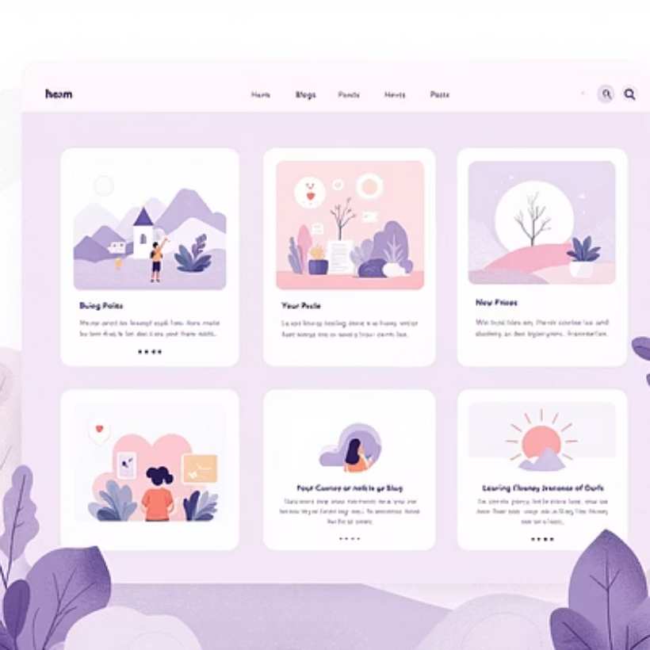


Key Features Demonstration
Intuitive Post Editor
Clean Reading Experience
Interactive Community
Rich text formatting with real-time preview functionality
Optimized typography and layout for enhanced readability
Seamless commenting and engagement features

Slide 11




Conclusion & Future Enhancements
Project Achievements
BlogSpace successfully delivers a student-focused blogging platform that balances simplicity with functionality. The platform addresses the identified gap in accessible blogging solutions for academic communities.
Current Success
Functional blogging platform with essential features
Future Enhancements
Advanced themes, multimedia support, and collaboration tools
Scalability
Potential for campus-wide deployment and feature expansion
.

